Slide 1

Not for your average brain:
Metaphor as social practice in an underground hiphop community
Brendan O’Connor
Gilbert Brown
Department of Language, Reading & Culture
University of Arizona
SALSA XVI
April 11, 2008

Slide 2
Theoretical Framework
Anthropology of Literacy
    Szwed (1981, p. 422):
    “.. the social meaning of literacy: that is, the roles these abilities play in social life; the varieties of reading and writing available for choice; the contexts for their performance; and the manner in which they are interpreted and tested”
Communities of Practice model
    Wenger (1998, p. 4):
    “Learning as social participation … [a] process of being active participants in the practices of social communities and constructing identities in relation to these communities”
Enregisterment of style
Agha (2007, p. 55):
    Process “whereby diverse behavioral signs (whether linguistic, non-linguistic, or both) are functionally reanalyzed as cultural models of action, [and] as behaviors capable of indexing stereotypic characteristics of incumbents of particular interactional roles”

Slide 3
The Participant
Jay
→ MC and co-founder of ILL Methods, an “underground Native hiphop crew comin out the Southwest”
→ 25 years old
→ Lives in Farmington, NM, a reservation border city
→ Has been producing and performing hiphop for around 2 years

Slide 4
Data Collection and Analysis
In-depth Interview
→ Around 2 hours
→ Conducted at University of Arizona Native American Student Affairs office
→ Open-ended questions/prompts developed by listening to ILL Methods’ most recent mixtape CD, “Phrase, Jay, Knowbody: ILL Methods”
Transcription and analysis of interview data
    → Interviews videotaped and viewed in their entirety
    → Transcribed selected segments based on themes emerging from data
    → Analyzed transcribed segments with reference to recent work in linguistic anthropology and education
    → Sought to foreground our participant’s insider perspective on underground hiphop

Slide 5
“Listen to the whole thing”
1 So it’s basically sayin, y’know,
2 if you have enough-
3 just say, y’know, you wanna know what it is,
4 I mean, you would go and find out what it is.
5 Listen to it, listen to it, listen to it.
6 “Oh, that’s what it means,” y’know
…
7 When other people listen to him,
8 they’re like, what is he talkin about?
9 I’m like, listen to the name of the track
10 and listen to it, y’know you-
11 don’t just listen to the lyrics or the beat,
12 listen to the whole thing
13 and you’ll understand it.

Slide 6
“There is like a code”
1 The people that are underground?
2 They’ve- … they’ve been doin it for so long
3 that there is like a code, y’know, like- …
4 there’s like a code of (pause)
5 of what you understand …
6 They’ve been doin it for so long,
7 they’ve been in it for so long,
8 so- so- so one of like a brethren or – y’know,
9 that we call our MCs brethren, like a brother –
10 and say he says something,
11 y’already know what he’s saying …
12 “Oh, tha’s dope,” y’know? so …
13 I guess it’s for the average person to scramble.

Slide 7
“You’re not gonna please everybody”
1 J: So either way it’s-
2 you’re not gonna please everybody,
3 and you don’t hear like- like-
4 not a lot of, y’know, elder people
5 listening to our music, and y’know-
6 Int: And does that-
7 does that bother you, or-
8 J: No, that stuff doesn’t bother me.
9 I’ll- I’ll- I don’t care.

Slide 8
“It’s a metaphor”
1 Like some of the stuff I say is not- …
2 it’s- it’s a metaphor. Like I got this line, I say,
3 “Eat infants to digest effect of dialect” …
4 and it says, y’know, but I know when I say
5 (starts rapping) but I- I know rap is innocent,
6 but I’m a cannibal who eats his own hypocrites,
7 (stops rapping) cause rappers are hypocrites y’know …
8 well if somebody heard that, a person …
9 they’re not gonna understand it.
10 But they’re gonna be like-
11 all they’re gonna hear is “eatin’ infants,”
12 “a cannibal who eats his own hypocrites” …
13 But a MC would be like, oh, that’s pretty dope, y’know
14 like … like this guy don’t care, y’know.

Slide 9
“You have to solve it to- respect the music”
1 You know a riddle was like a- hard to solve, right?
2 Well, if you look at a metaphor it’s kind of-
3 it’s a riddle y’know? And when we say stuff,
4 if you don’t understand what we’re saying
5 then it’s- it’s more of a riddle, y’know,
6 and it’s basically like-
7 saying that you have to solve it to-
8 respect the music, y’know, kind of …
9 that’s what the word kind of means to me, y’know.

Slide 10
“So I got culture?”
1 He’s like, “So you’re saying human beings
2 can use their brainwaves and remember all this?” …
3 He’s uh- “Then (???) won’t have to go
4 to school no more,” y’know. It’s basically
5 he’s talkin about MCs, y’know …
6 “So you’re sayin these kids
7 don’t have to go to school no more?”
8 And he’s like, “So you’re done?”
9 And he was like, “Yeah.”
10 “So I got culture?”
11 And he’s talkin about like hiphop culture, y’know.

Slide 11
“Brain Anatomy 101”
1 That [track] Brain Anatomy’s just talkin about how- …
2 it’s like a philosophy kinda, y’know …
3 like how you usin the brain, Brain Anatomy 101,
4 and how I use the brain to spit lyrics, y’know …
5 an it gets really- really intricate in there, y’know,
6 almost like real- really hard to understand
7 what I’m talkin about but …
8 if you’re either smart and you know a lotta words …
9 or if you’re an MC,
10 you know what I’m talkin about
11 and you can get it, y’know, and that’s what it is.
12 It’s brain anatomy 101, y’know, it’s- …
13 it’s not for the average brain.

Slide 12
References
Agha, A. (2007). Language and social relations. Cambridge, UK: Cambridge University Press.
Szwed, J. (1981). The ethnography of literacy. In M. Farr Whiteman (Ed.), Writing: the nature, development, and teaching of written communication, Vol. I (pp. 13-24). Mahwah, NJ: LEA.
Wenger, E. (1998) Communities of practice. Cambridge, UK: Cambridge University Press.

Slide 13
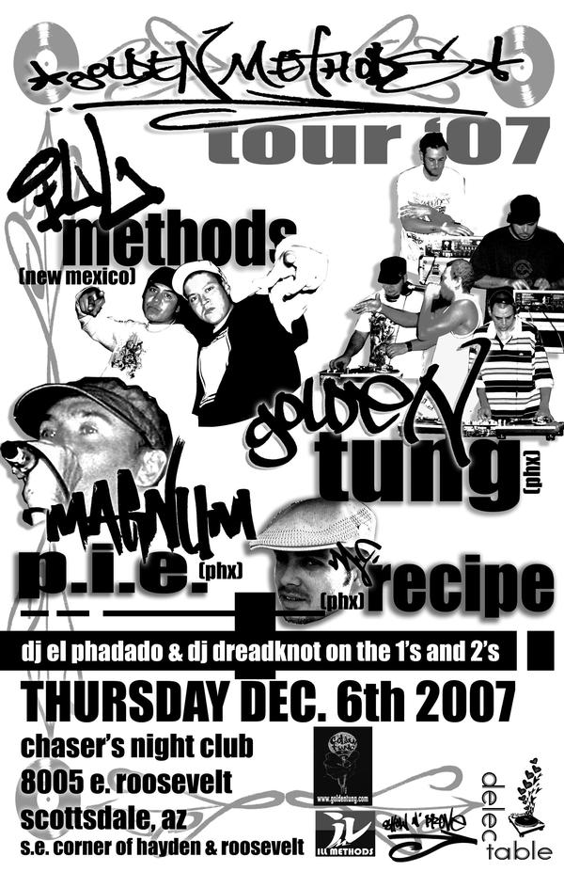
oconnorb@email.arizona.edu
gilbertb@email.arizona.edu
www.myspace.com/illmethodsjay/
THANKS TO:
Perry Gilmore
Jane Hill
Norma Mendoza-Denton
Jennifer O’Connor
Leisy Wyman
And especially to:
J Ent and the ILL Methods crew

